Slide 1
Capstone Project – 2 Seoul Bike Sharing Demand Prediction Puneet Suthar

Slide 2

What are we talking about ?

Slide 3
Content :
Introduction to Bike rentals
Problem Statement
General overview of the dataset
Data cleaning
Exploratory Data Analysis
Web application
Conclusion

Slide 4
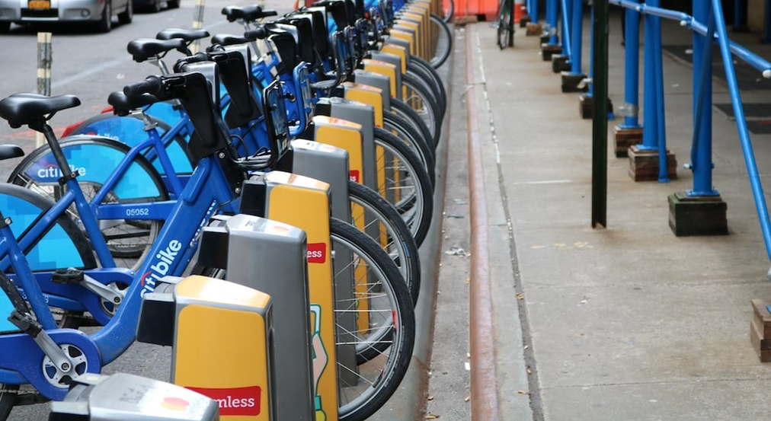
Introduction
Bike rentals have experienced a surge in popularity in recent years, with people using the service more frequently due to its relatively affordable rates and convenience of pick:up and drop:off at their own discretion. Ensuring the availability and accessibility of rental bikes to the public at the appropriate times reduces waiting time and ultimately provides a steady supply of bikes to the city. The objective of this project is to develop a machine learning model capable of forecasting the demand for rental bikes in Seoul.

Slide 5
Problem Statement
Currently Rental bikes are introduced in many urban cities for the enhancement of mobility comfort. It is important to make the rental bike available and accessible to the public at the right time as it lessens the waiting time. Eventually, providing the city with a stable supply of rental bikes becomes a major concern. The crucial part is the prediction of bike count required at each hour for the stable supply of rental bikes.

Slide 6
How our dataset Look like ?

Slide 7
General overview of the dataset
14 Columns
&
8760 Rows

Slide 8
General overview of the dataset
14 Columns
Date : year:month:day
Rented Bike count : Count of bikes rented at each hour
Hour : Hour of the day
Temperature : Temperature in Celsius
Humidity : %
Wind Speed : m/s
Visibility : 10m
Dew point temperature : Celsius
Solar radiation : MJ/m2
Rainfall : mm

Slide 9
General overview of the dataset
14 Columns
Snowfall : cm
Seasons : Winter, Spring, Summer, Autumn
Holiday : Holiday/No holiday
Functional Day : No(Non Functional Hours), Yes(Functional hours)

Slide 10
General overview of the dataset
14 Columns
Some columns have very high No. of Zeros :-
a. Solar Radiation (MJ/m2) – 4300
b. Rainfall(mm) - 8232
c. Snowfall (cm) – 8317
In a day we have 24 hours and we have 365 days a year so 365 X 24 = 8760, which are the no.of lines in the given dataset.
'Seasons','Holiday', 'Functioning Day','Hour' are the categorical columns.
No null values
No duplicated value.

Slide 11
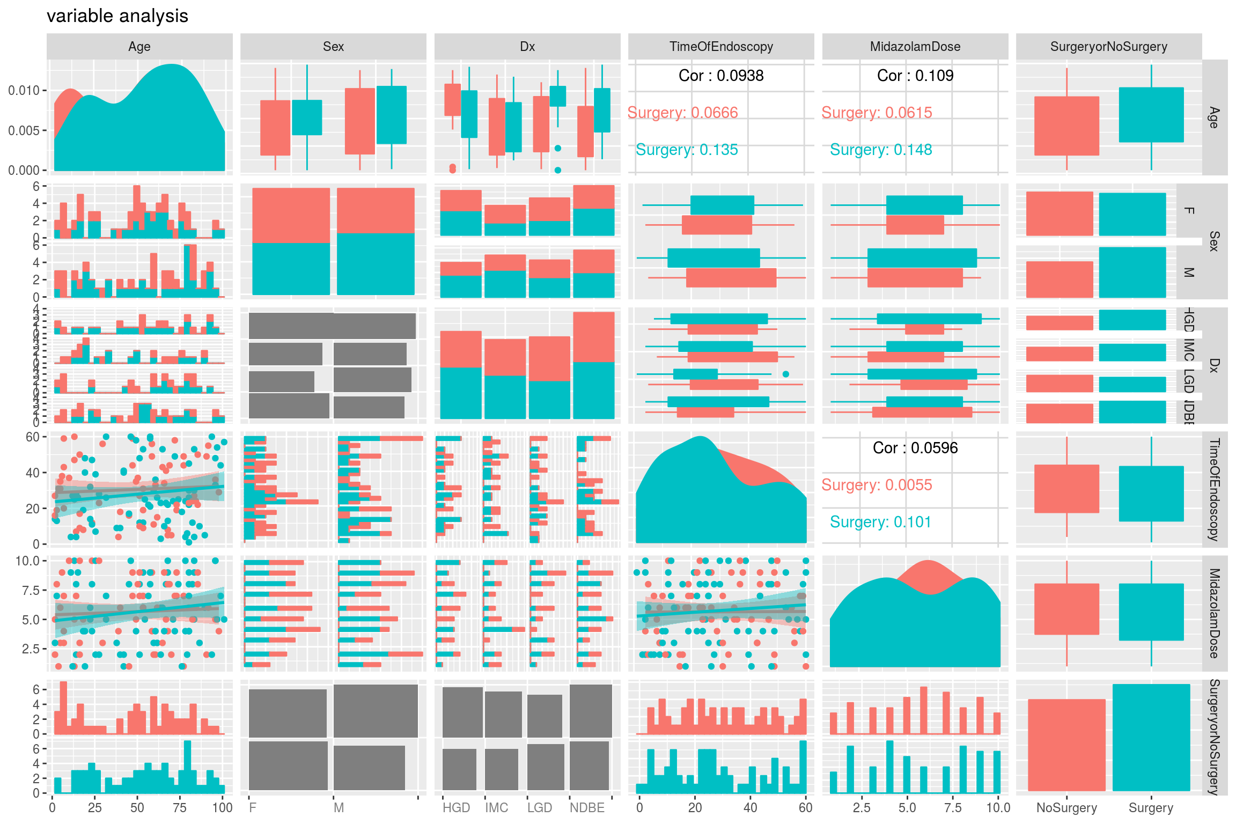
EDA
(Exploratory Data Analysis)

Slide 12
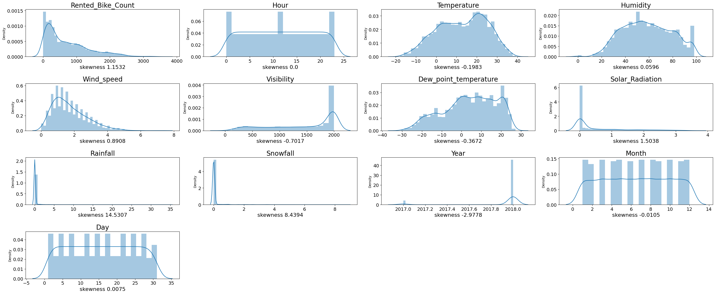
EDA
(Exploratory Data Analysis)
Distribution plot & skewness

Slide 13
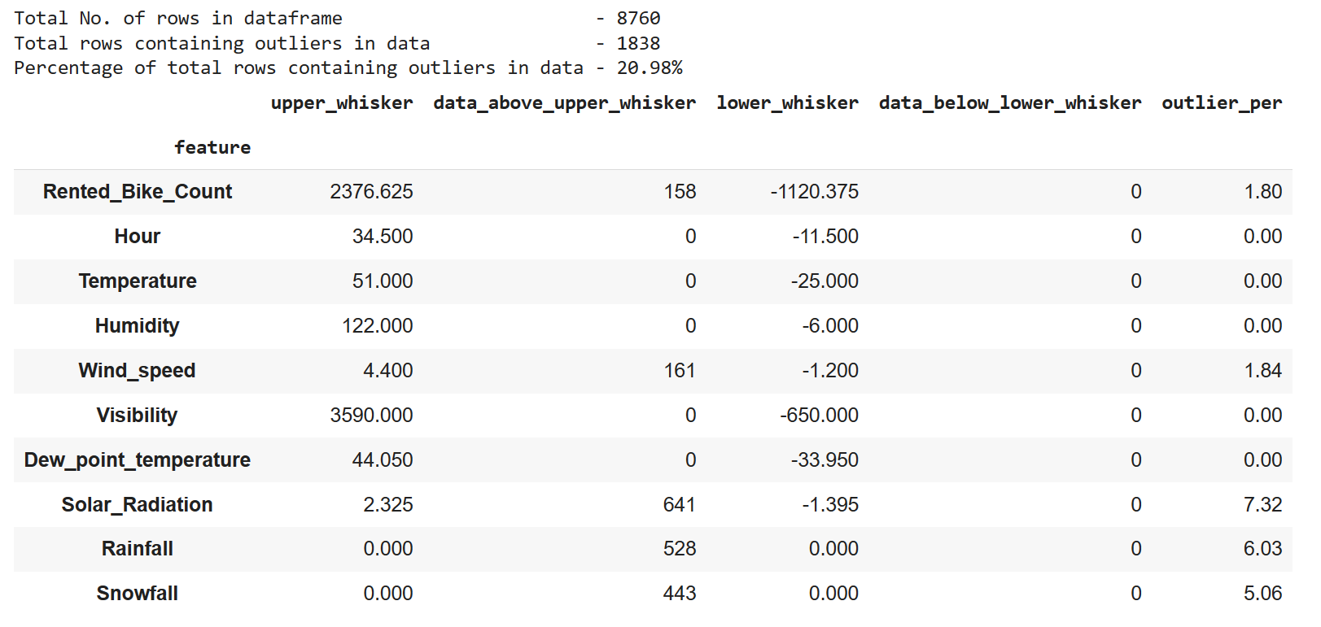
EDA
(Exploratory Data Analysis)
Outliers

Slide 14
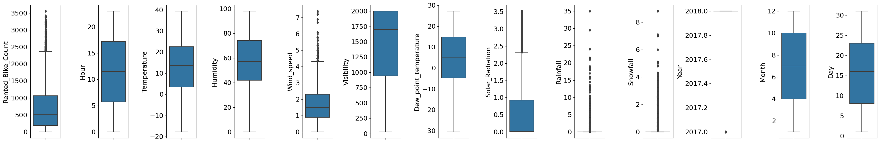
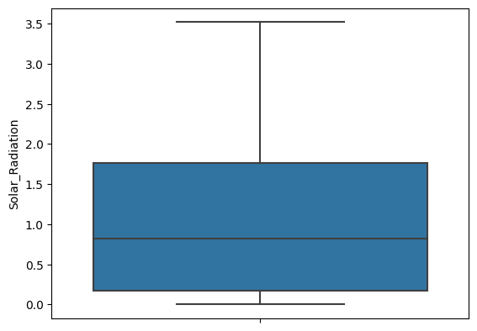
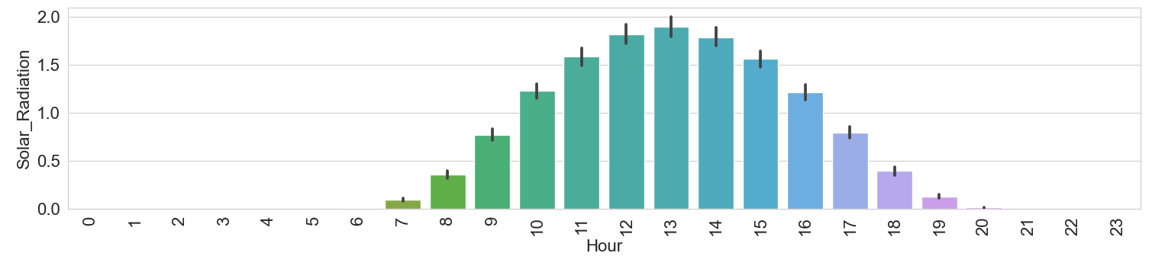
EDA
(Exploratory Data Analysis)
Box Plot
Before outlier removal
Box plot of solar radiation between 5 am to 7pm

Slide 15
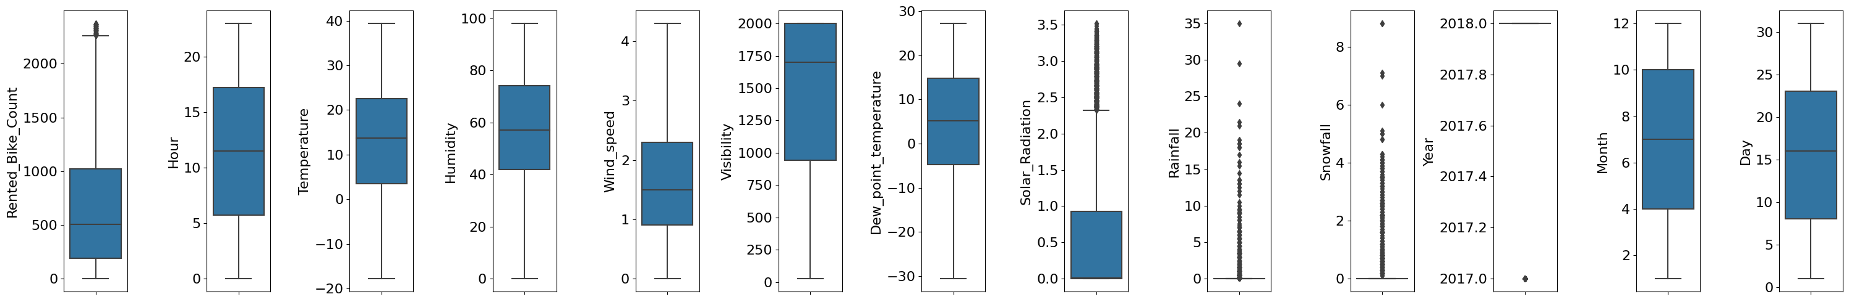
EDA
(Exploratory Data Analysis)
Box Plot
Before outlier removal
After replacing the outlier by median

Slide 16
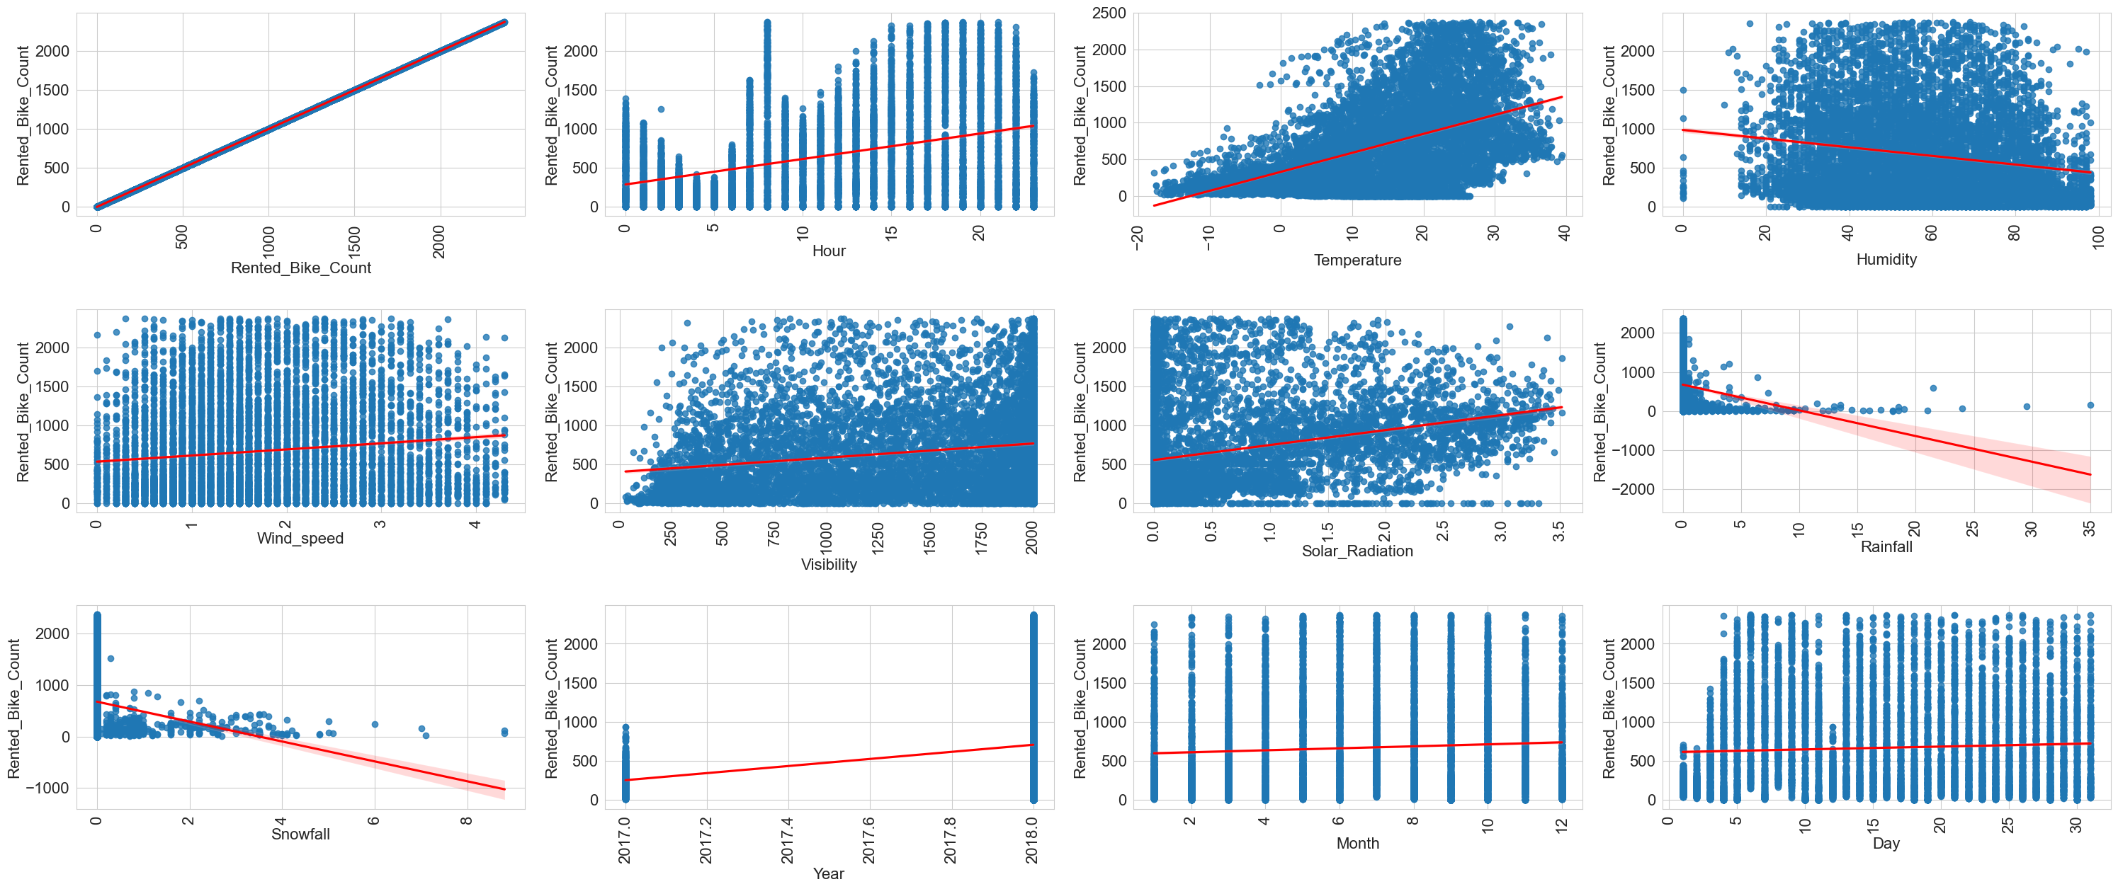
EDA
(Exploratory Data Analysis)
Regression Plot
Most of the features Doesn't show any linear relationship with target column
Only solar radiation and temperature shows a bit

Slide 17
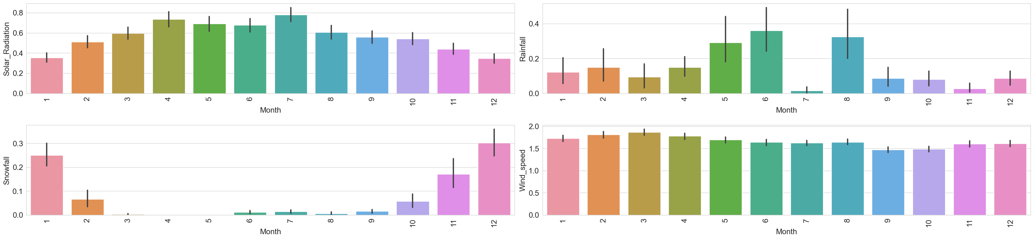
EDA
(Exploratory Data Analysis)
Bar Plot
There is a huge impact on Solar_Radiation, Rainfall and Snowfall in different months

Slide 18
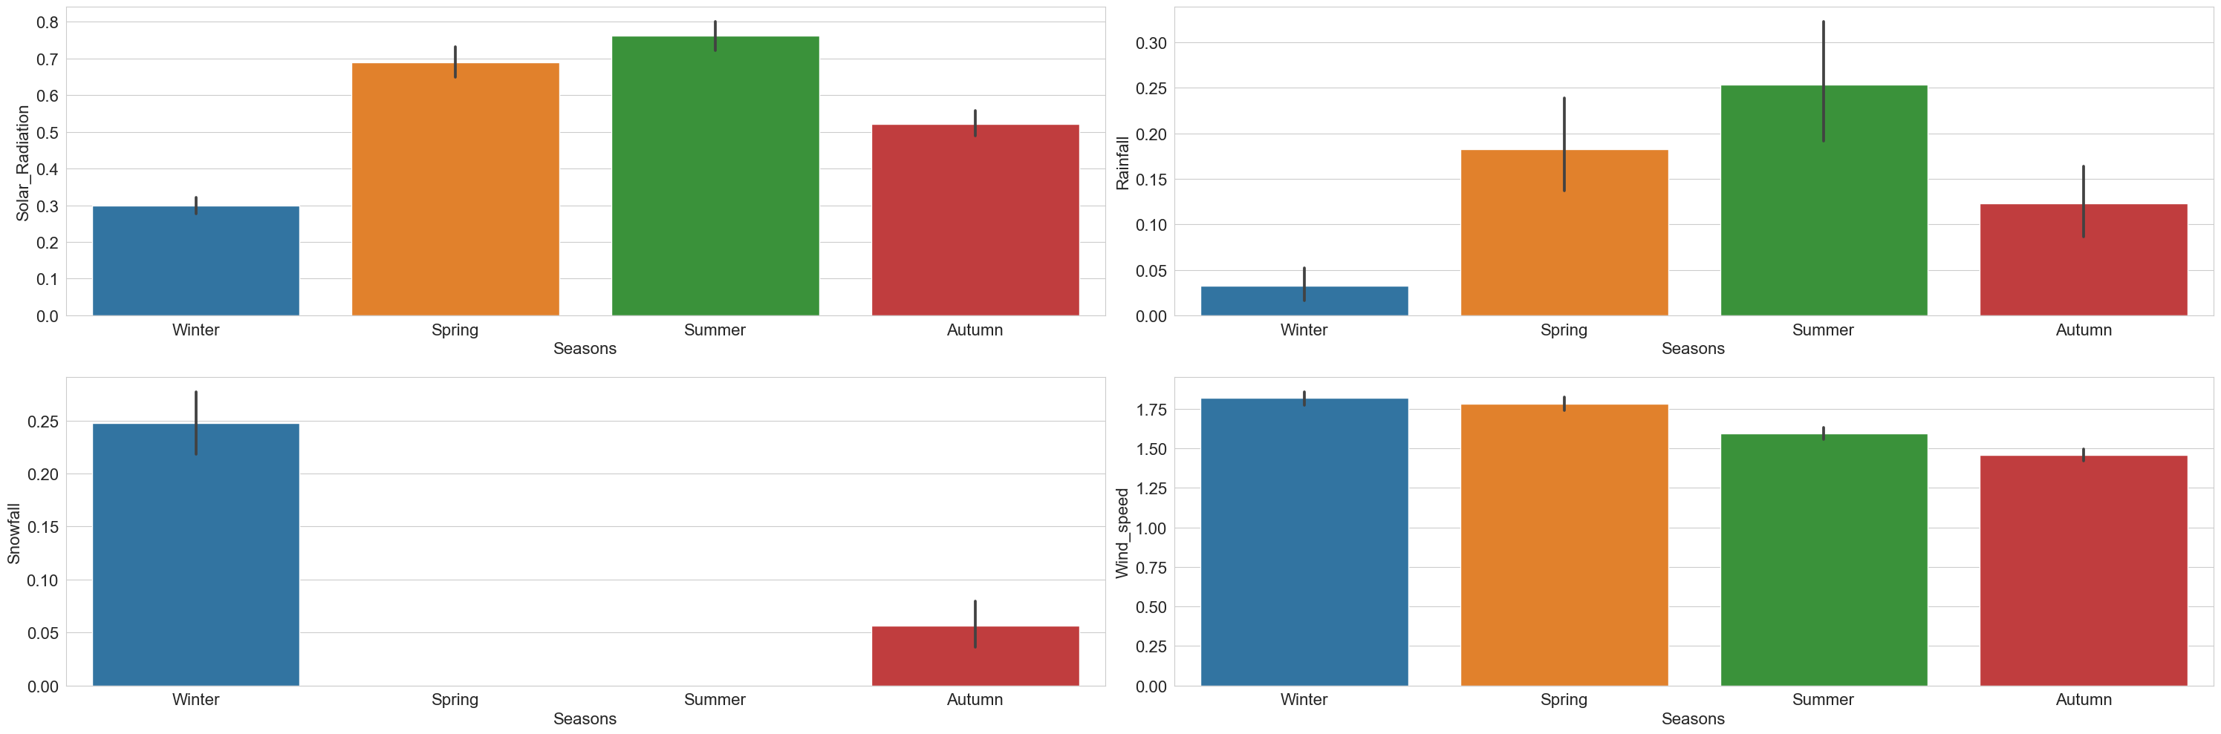
EDA
(Exploratory Data Analysis)
Bar Plot
As we can see the snow fall and rainfall are highly related to the seasons, so these are the outliers, but the data is correct.

Slide 19
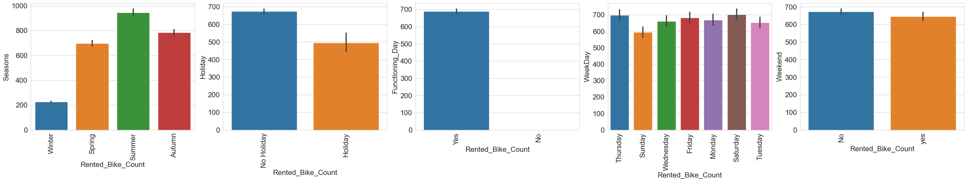
EDA
(Exploratory Data Analysis)
Bar Plot
Bike demand is lower in winter.
Demand is higher in on non holiday.
Demand is lower on weekends, Sunday.

Slide 20
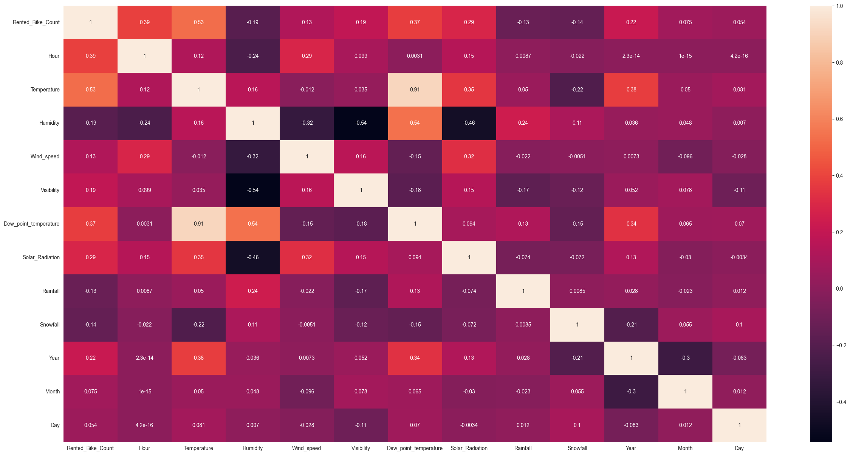
EDA
(Exploratory Data Analysis)
Correlation heatmap

Slide 21
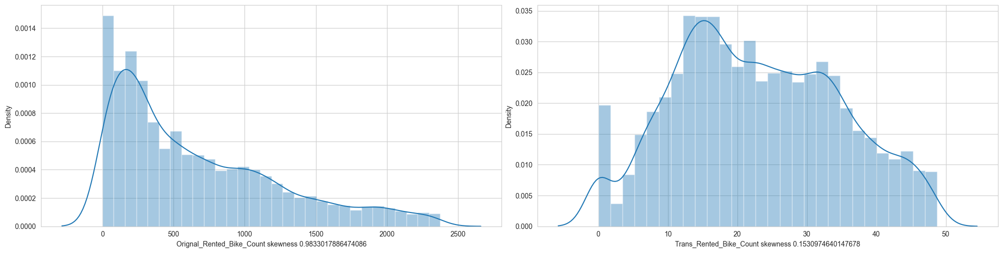
Handling skewed column
Applied square root transformation
Before
After

Slide 22
Model Building

Slide 23
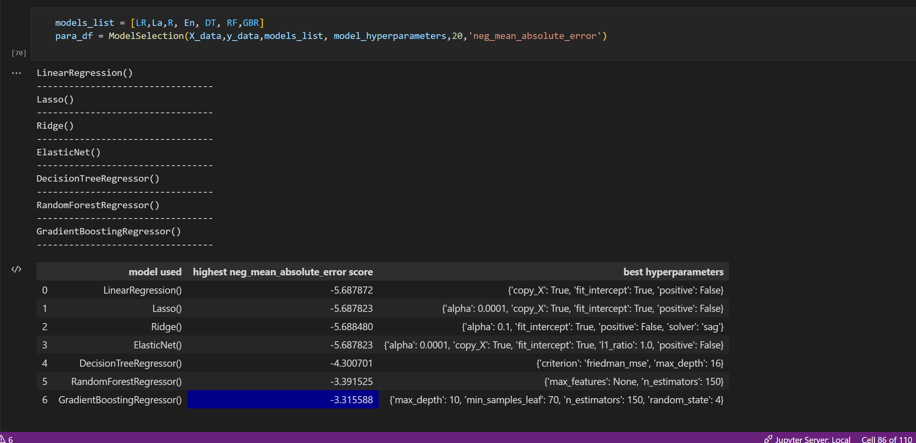
Model Building
Hyperparameter tuning

Slide 24
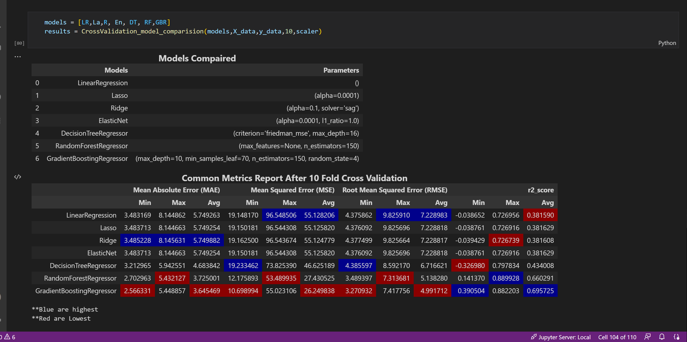
Model comparision

Slide 25
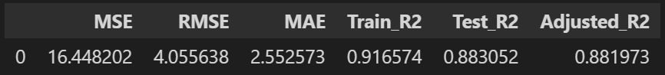
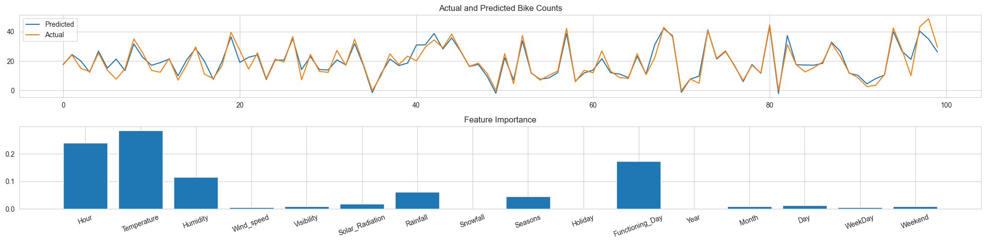
Best model
GradientBoostingRegressor (max_depth =10,
min_samples_leaf =70,
n_estimators =150,
random_state =4)

Slide 26
Web application

Slide 27
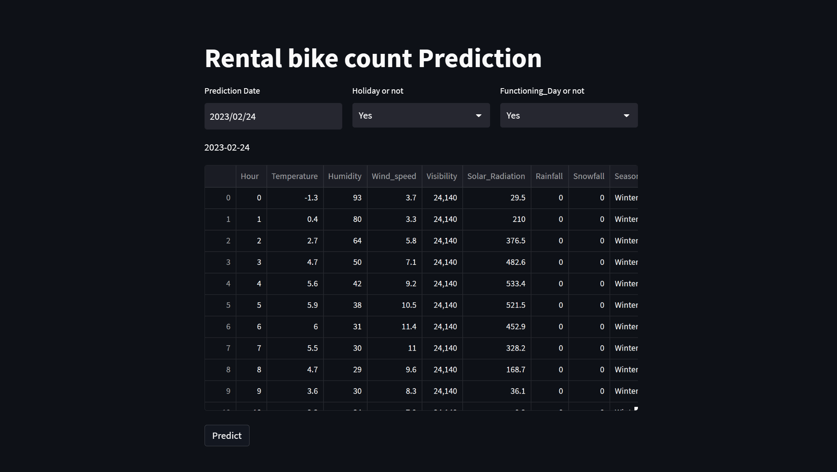
Web application

Slide 28
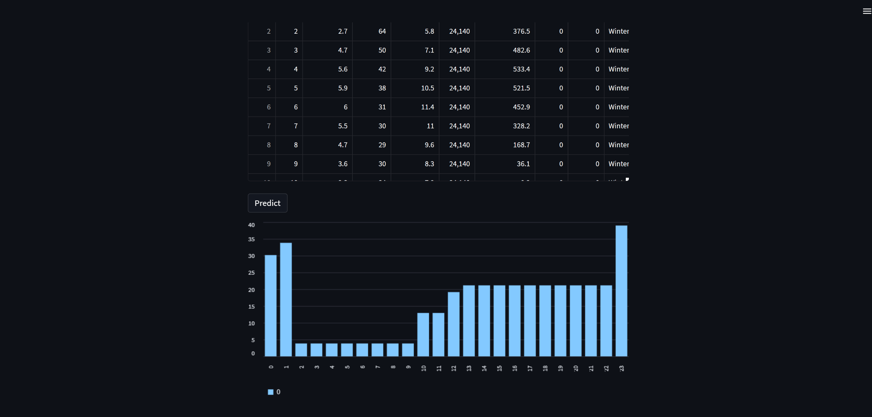
Web application

Slide 29
Conclusion

Slide 30
Conclusion
We trained 7 models for our machine learning project to forecast bike rental demand based on weather conditions and other factors. We refined each model through hyperparameter tuning and found that the Gradient Boost model had the lowest RMSE, making it an excellent choice for accuracy-focused businesses. However, the decision tree model may be preferable for businesses that value model interpretability. Overall, our project developed accurate predictive models that can optimize rental operations and improve business outcomes.

Slide 31
Q & A

